Slide 1

DIGITAL SILK ROAD
AI: A Bridge Narrowing
the Digital Gap
And Promoting the Belt and Road Initiative
A Thematic Keynote · Digital Silk Road · 2026
Notes:
Good morning, distinguished delegates, partners, and friends. Thank you for joining this keynote on the Digital Silk Road. For the next few minutes I want to share one simple idea: artificial intelligence is not a wall between nations, but a bridge that narrows the digital gap. Let us begin by looking honestly at the divides we still face.

Slide 2
THE DIGITAL DIVIDE
Three Divides Still
Separate the World
Economic & trade divide
01
Language barriers block small enterprises from global markets.
Language, learning and
infrastructure still keep too
many communities outside
the global economy.
Education divide
02
Under-resourced schools cannot give every child a personal tutor.
Infrastructure divide
Each divide is a missing bridge.
03
Developing regions lack the funds to connect remote communities.
AI · Digital Silk Road
02
Notes:
Before we talk about solutions, we must name the problem. Three divides still separate too much of our world: a gap in economic and trade opportunity, a gap in education, and a gap in infrastructure. These are not abstract statistics; they decide whether a small business can sell abroad, whether a child can learn, and whether a remote community can reach the global market. AI is powerful enough to confront all three.

Slide 3

THE LANGUAGE WALL
Real-Time Translation Erases the Language Wall
STEP 01
STEP 02
STEP 03
Vietnamese SME
AI translation glasses
European partner
A local seller with a
Many languages handled
Direct negotiation, with
product to offer.
in real time, no middleman.
no language barrier.
TAKEAWAY
AI puts small enterprises on a
truly balanced global stage.
AI · Digital Silk Road
03
Notes:
The first wall we can tear down is language. Picture a Vietnamese small enterprise sitting across the table from a European partner, with no interpreter in the room. AI translation, worn almost like a pair of glasses, listens and speaks in real time, so the negotiation happens directly, person to person. That is what it means to put small enterprises on a truly balanced global stage.

Slide 4
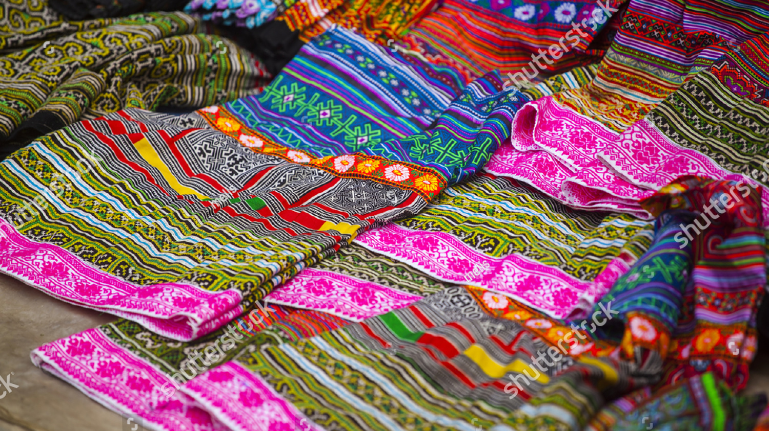
GLOBAL MARKETPLACE
CULTURE, CONNECTED
From Local Heritage to
International Demand
Guatemalan crafts find their match in international online markets.
AI · Digital Silk Road
04
Notes:
Now think about culture. In Guatemala, artisans create products that carry a unique heritage, yet for years they struggled to find buyers beyond their own region. AI helps them match those cultural products with international online markets, turning local craft into global demand. When a developing country's culture reaches the world, it expands both its influence and its dignity.

Slide 5
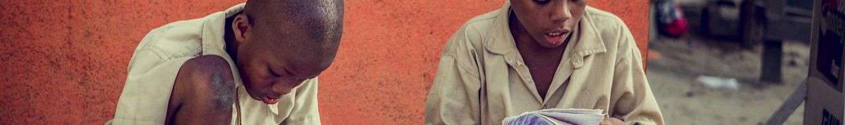
THE EDUCATION DIVIDE
Filling the Education Divide, One Learner at a Time
01
02
03
04
STEP 01
STEP 02
STEP 03
STEP 04
Deliver
Adapt
Overcome
Carry
AI apps like Robotutor
Lessons adapt to each
Overcomes the teacher
An active bridge, carrying
deliver personalized math
individual learner’s own
shortage across
knowledge and
and reading lessons on
pace, meeting every
under-resourced
opportunity to the
local tablets.
student where they are.
African schools.
next generation.
AI · Digital Silk Road
05
Notes:
The second divide is education, and here the shortage of teachers is the hardest constraint. Across under-resourced schools in Africa, AI-powered applications such as Robotutor deliver personalised math and reading lessons in local languages, straight to a student's tablet. Every learner moves at their own pace, because the app adapts to them. This is an active bridge, carrying knowledge and opportunity to children who were once left behind.

Slide 6
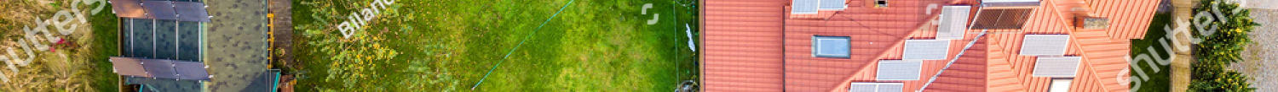
THE INFRASTRUCTURE DIVIDE
Building the Shortest Path to Opportunity
From satellite analysis to clean power, in three connected stages.
1
STAGE ONE
2
STAGE TWO
3
STAGE THREE
Analyse
Connect
Power
Reads satellite imagery
Reaches remote villages
Distributes solar energy
Plans the shortest route
Links them to markets
Powers local enterprises
Cuts construction cost
Builds shared networks
Improves student learning
Route plan
Connected
Powered grid
One route, one grid, one connected future.
AI · Digital Silk Road
06
Notes:
The third divide is infrastructure, where the shortage of funds is the main dilemma. In Tanzania, AI analyses satellite images to plan the shortest and least expensive route, connecting remote communities to world markets. It also helps local managers distribute solar energy to enterprises and schools, lifting production efficiency and improving student learning. One route, one grid, one connected future.

Slide 7
THE SYNTHESIS
Four Divides, One Connected Stage
Trade · Education · Culture · Infrastructure
Trade
Education
Culture
Infrastructure
The bridge is not a barrier — it is the stage where everyone trades, learns and grows.
AI · Digital Silk Road
07
Notes:
So step back and look at what we have built together. Trade, education, culture, and infrastructure are no longer four separate struggles; they are four pillars of a single connected stage. The bridge is not a barrier. It is the place where everyone can trade, learn, and grow. That is the real promise of the Digital Silk Road.

Slide 8
THE CALL TO ACTION
Jointly Build the Digital Silk Road
Four shared commitments that turn a vision into a connected future.
01
02
03
04
PILLAR 01
PILLAR 02
PILLAR 03
PILLAR 04
Share the technology
Open the markets
Invest in people
Build together
Make AI tools open and
Connect small producers
Train teachers, workers
Govern AI through
affordable for every
to global buyers through
and entrepreneurs for
shared rules and
Belt and Road partner.
digital trade.
the digital era.
mutual trust.
AI · Digital Silk Road
08
Notes:
How do we turn this vision into action? Through four shared commitments. Let us share the technology, making AI tools open and affordable for every partner. Let us open the markets, connecting small producers to global buyers through digital trade. Let us invest in people, training teachers, workers, and entrepreneurs for the digital era. And let us build together, governing AI through shared rules and mutual trust.

Slide 9

THE DIGITAL SILK ROAD
AI is a bridge,
not a barrier.
We should jointly spare no efforts to explore
the possible path of the Digital Silk Road.
Thank you.
AI · Digital Silk Road
09
Notes:
In closing, I leave you with one conviction. AI is a bridge, not a barrier. If we jointly spare no efforts to explore the possible path of the Digital Silk Road, we can narrow the digital gap between our countries and carry knowledge and opportunity to everyone. Thank you.

